Slide 1
Mathematical concepts
Measures of Variation
Class 3

Slide 2
Measures of Central Tendency
Measures of central tendency:
Typical, central, representative, or average value (case) in the distribution
Mean, Median, Mode

Slide 3
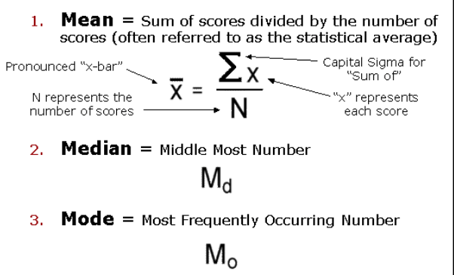
Three Measures of
Central Tendency
Mode: the value that occurs most frequently in the distribution
Median: the middle value in a distribution of rank ordered scores
Mean: an arithmetic average of a set of scores

Slide 4
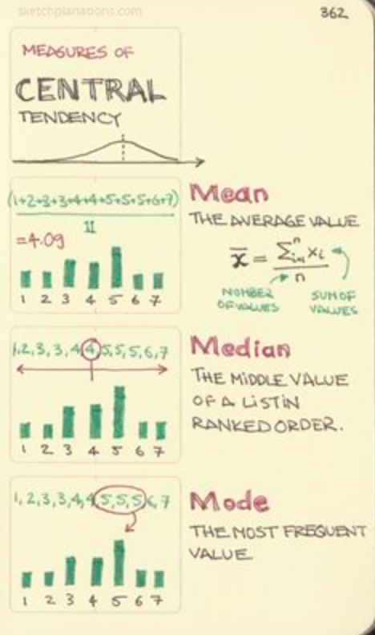
Calculations
 | Mode | Median | Mean
Nominal | x
Ordinal | x | sometimes
Interval | x | x | x (skewed possibly)
Ratio | x | x | X (skewed possibly)
Mean – sensitive to scores in the distribution
  Sensitive to extreme scores

Slide 6
Measures of variability (dispersion)
Measures of variability
Tell you the distributions of interval/ratio level data
Range, interquartile Range, Variance, Standard deviation

Slide 7
Measures of Dispersion for interval-ratio variables
Range (R): the distance between the highest and lowest scores in the distribution
R = max - min
Which group is more dispersed?
Group A: 1 3 5 7 9 11 13 15 17 19 21 23
Group B: 1 1 1 1 1 5 5 5 5 5 5 24
* Sometimes score does not reflect the degree of dispersion

Slide 8
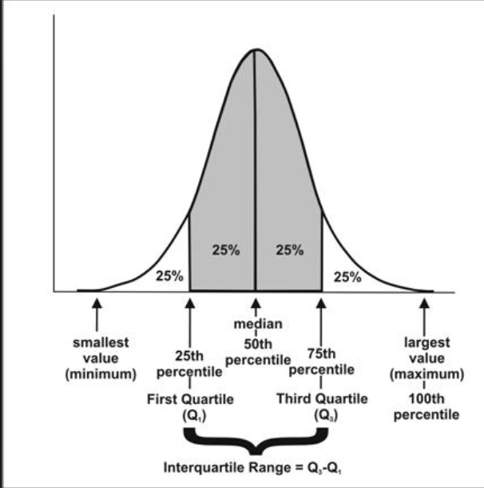
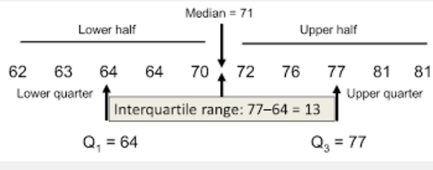
Measures of Dispersion for interval-ratio variables
A measure of the ‘middle fifty’, or where the bulk of the values lie.
Inter Quartile Range (IQR): the distance from the third to the first quartile
IQR = Q3 - Q1
Notes:
The interquartile range (IQR) is a measure of variability, based on dividing a data set into quartiles.
Quartiles divide a rank-ordered data set into four equal parts. The values that divide each part are called the first, second, and third quartiles; and they are denoted by Q1, Q2, and Q3, respectively.
Q1 is the "middle" value in the first half of the rank-ordered data set.
Q2 is the median value in the set.
Q3 is the "middle" value in the second half of the rank-ordered data set.
The interquartile range is equal to Q3 minus Q1.

Slide 9
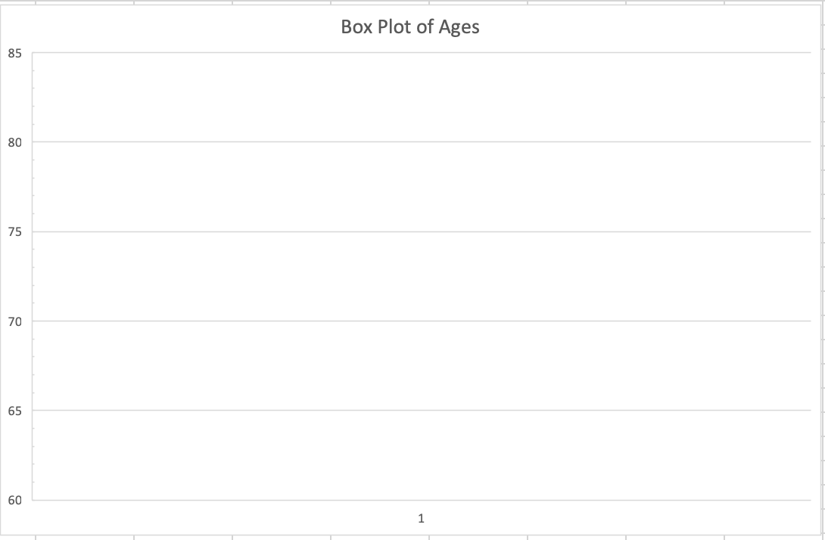

Creating a Box Plot
81
Create your Five Number Summary
Find the Minimum Score = 62
Find the Maximum Score = 81
Find the Median = 71
Find Q₁ = 64
Find Q₃ = 77
Plot it on your graph
Add in the Median Score
Add in the Mean Score
77
$\overline{x}$= 71
71
64
62

Slide 10
Measures of Dispersion & Normal Distribution

Slide 11

Standard Deviation
(the most frequently used measure of variability)
Deviation score
  Tells how far the raw score is from the mean of its distribution
    $x−\overline{x}$
  Standard Deviation – the average amount of variation in a set of scores
    The average distance from the mean
    The larger the SD, the larger the average distance each data point is from the mean of the distribution
  $$S= \sqrt{\frac{Σ{\left(x−\overline{x}\right)}^{2}}{n−1}}$$
  Where
  S is the standard deviation
  $Σ$ is sigma, which tells you to find the sum
  X is the individual score
  $\overline{x}$is the mean of all the scores
  N is the sample size

Slide 12

Variance
Is….
  Just the Standard Deviation Squared
  Not a meaningful interpretation of data
$$s^{2}=\frac{Σ{\left(x−\overline{x}\right)}^{2}}{n−1}$$

Slide 13
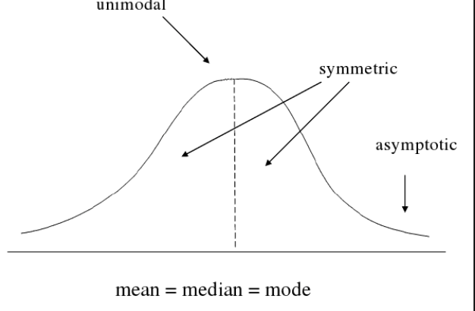
The Normal Curve
The normal curve (bell-shaped curve) is A visual representation of a distribution of scores that three characteristics
  Mean, median, mode are equal to one another
  The normal curve is perfectly symmetrical
  The tails of the normal curve are asymptotic (come closer and closer to the Horizontal axis, but never touch)

Slide 14
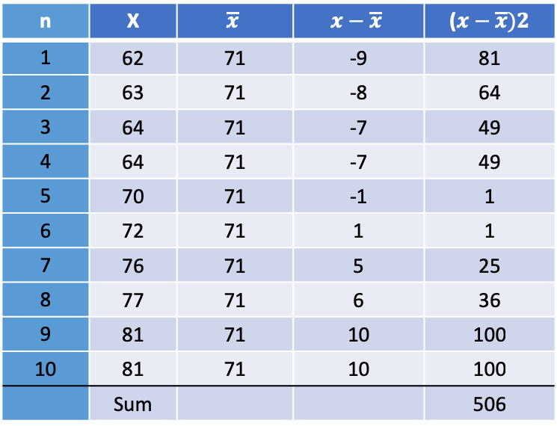
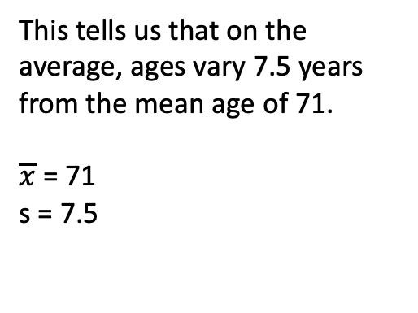
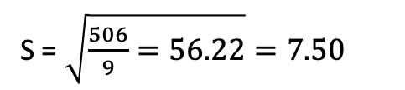
Calculating the Standard Deviation
$$S= \sqrt{\frac{Σ{\left(x−\overline{x}\right)}^{2}}{n−1}}$$
S = $\sqrt{\frac{506}{9}=56.22}=7.50$
n | X | $$\overline{x}$$ | $$x−\overline{x}$$ | ($x−\overline{x})2$
1 | 62 | 71 | -9 | 81
2 | 63 | 71 | -8 | 64
3 | 64 | 71 | -7 | 49
4 | 64 | 71 | -7 | 49
5 | 70 | 71 | -1 | 1
6 | 72 | 71 | 1 | 1
7 | 76 | 71 | 5 | 25
8 | 77 | 71 | 6 | 36
9 | 81 | 71 | 10 | 100
10 | 81 | 71 | 10 | 100
 | Sum |  |  | 506
This tells us that on the average, ages vary 7.5 years from the mean age of 71.
$\overline{x}$ = 71
s = 7.5
Notes:
n – 1 is an estimate of the population standard deviation,m and it is an unbiased estimate
We subtract 1 to force the standard deviation to be larger than it would be otherwise to be conservative in our estimates… overestimating what the standard deviationj of the poulatino is --

